Slide 1


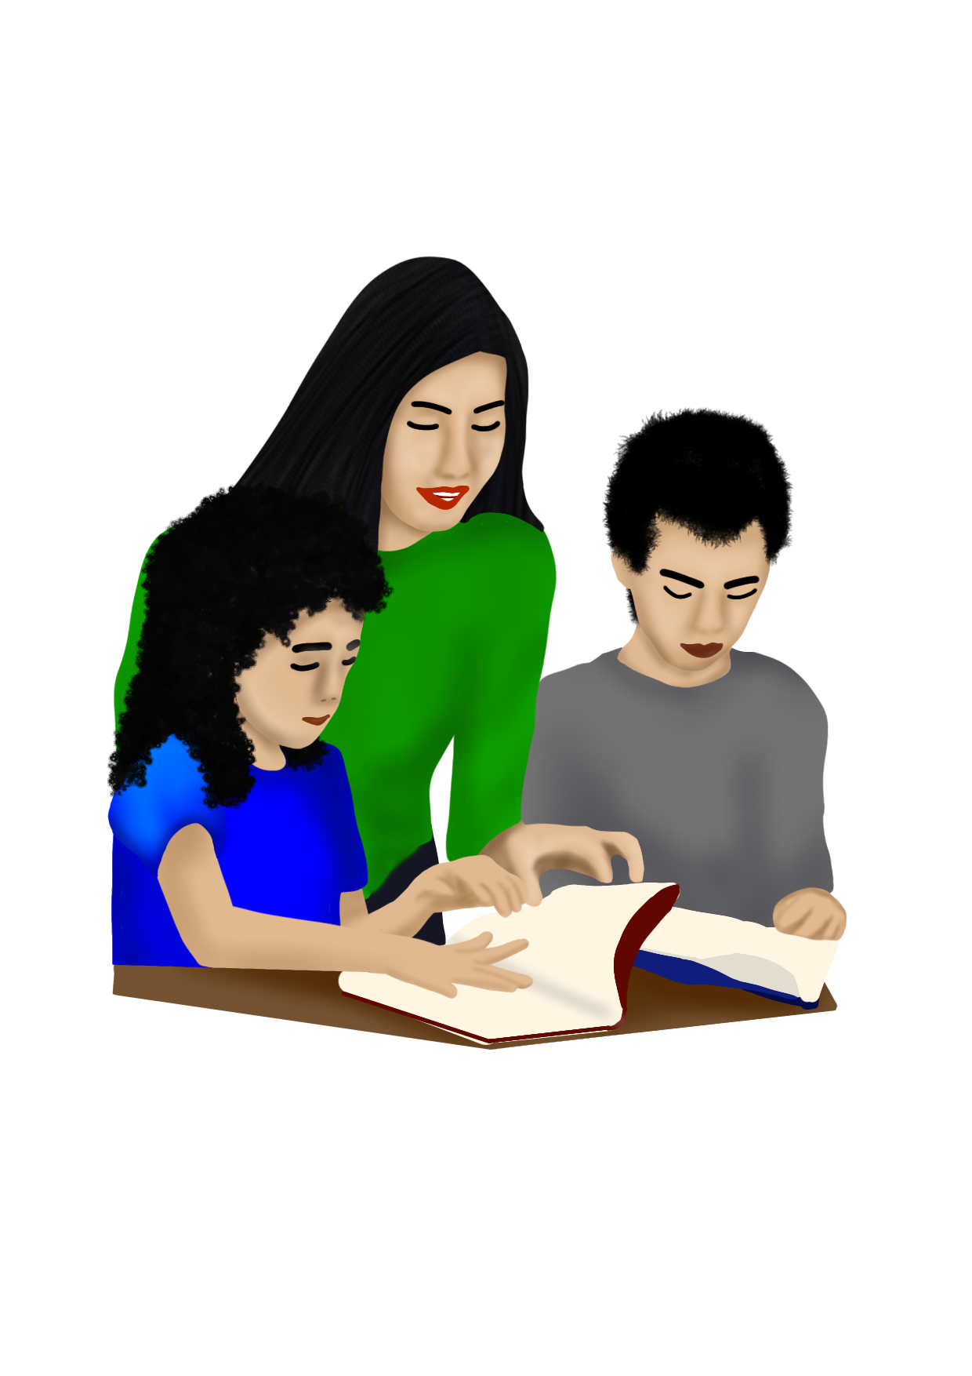

CONTEXTUALIZED AND LOCALIZED LEARNING MATERIALS FOR
READING INTERVENTION
STEP 6:
PHONICS PATTERNS
Alfonso B. Dagani Integrated School

Slide 2
DEVELOPMENT TEAM
Writers: Meriam P. Juguilon
Verna N. Magsigay
Virgelyn O. Paez
Marites A. Salabsab
Mary Jean Gladys S. Pereyra
Annabelle M. Salabao
Mary Rose E. Amper
Elvira M. Guzman
Arzylette B. Magsayo
Julieta S. Maisog
Illustrator: Arzylette B. Magsayo
Layout Artist: Arzylette B. Magsayo
Learning Resource Manager: (School LR Manager)Ailyn T. Estorba
(School Principal) Joel A. Mejorada
Alfonso B. Dagani Integrated School

Slide 3

Step 6
PHONICS PATTERNS

Slide 4
Phonics Patterns
Objectives: Tumong: | 1. Can read letter blends, digraphs, and glued sounds. Makabasa na sa letter blends, digraphs, and glued sounds.

Slide 5




dung
gan
dunggan
kwen
tas
kwentas
dung
gan
dunggan
kwen
tas
kwentas
+
+
+
+
=
=
=
=
mang
ga
mangga
mang
ga
mangga
ha
nger
hanger
+
ha
nger
hanger
+
=
=
+
+
=
=

Slide 6

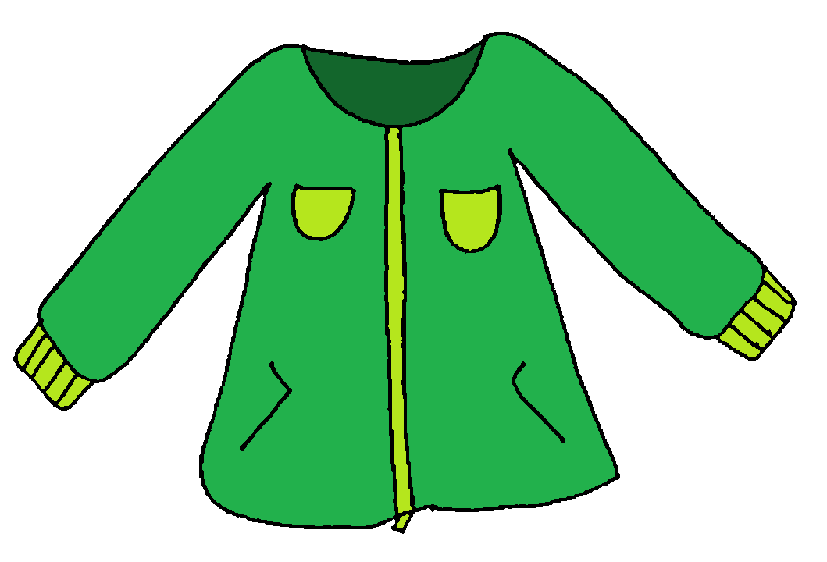
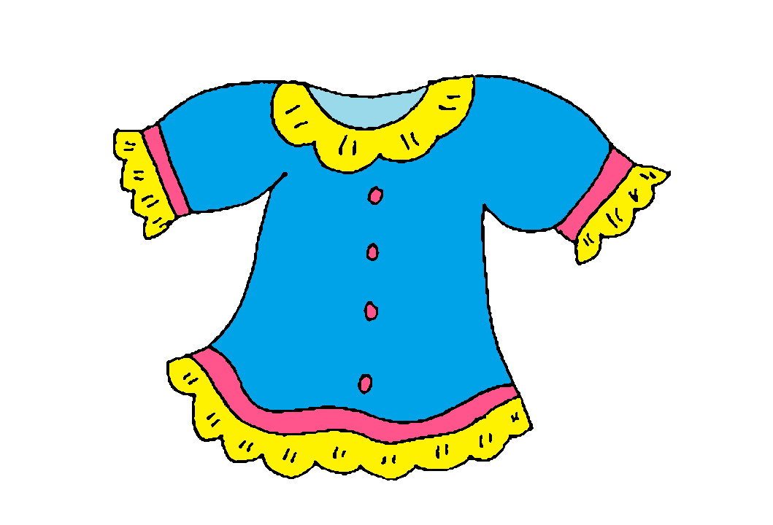

gri
po
gripo
dya
ket
dyaket
gri
po
gripo
dya
ket
dyaket
+
+
+
+
=
=
=
=
blu
sa
blusa
tra
po
trapo
blu
sa
blusa
tra
po
trapo
+
+
+
+
=
=
=
=

Slide 7




tab
la
tabla
nang
ka
nangka
tab
+
la
tabla
nang
+
ka
nangka
+
=
+
=
=
=
pla
to
plato
pla
to
plato
man
tsa
mantsa
+
man
tsa
mantsa
+
=
+
=
+
=
=

Slide 8
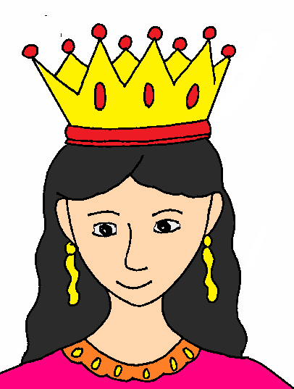



prin
se
sa
prin
se
sa
prinsesa
tsi
ne
las
prinsesa
tsi
ne
las
tsinelas
tsinelas
+
+
=
+
=
+
=
=
+
+
+
+
sob
re
sobre
sob
re
sobre
kra
yo
la
kra
yo
la
krayola
+
krayola
+
=
=
+
+
=
+
=
+

Slide 9

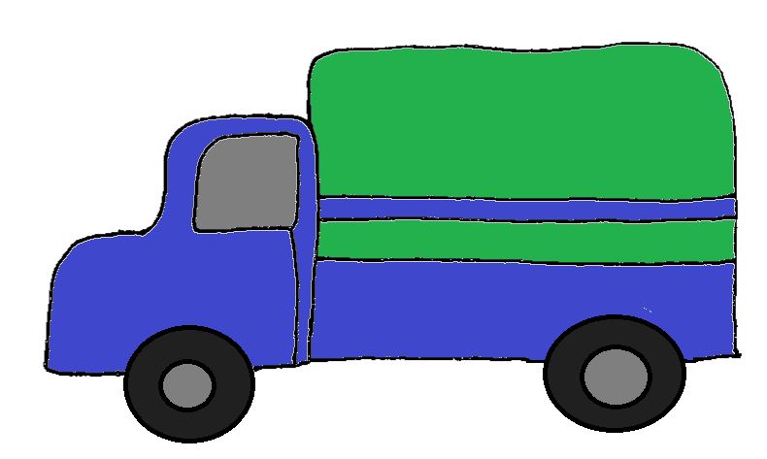

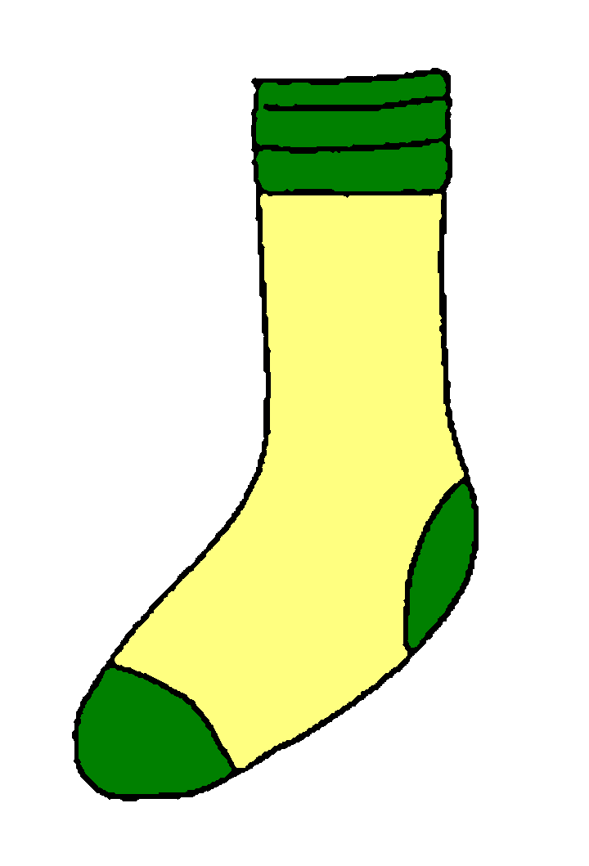
kru
s
krus
kru
s
krus
tra
k
trak
+
tra
k
trak
+
+
=
+
=
=
=
ta
long
talong
med
yas
medyas
ta
long
talong
med
yas
medyas
+
+
=
+
=
+
=
=

Slide 10




i
ring
iring
sa
ging
saging
i
ring
iring
sa
ging
saging
+
+
+
+
=
=
=
=
ya
hong
yahong
ya
hong
yahong
pa
yong
payong
+
pa
yong
payong
+
+
=
+
=
=
=

Slide 11
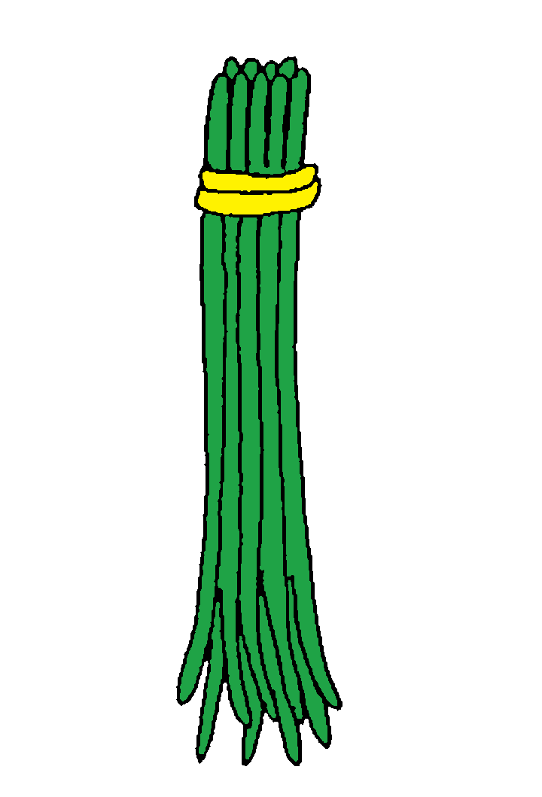



ba
tong
batong
ba
tong
batong
ob
long
oblong
+
ob
long
oblong
+
+
=
+
=
=
=
i
long
ilong
i
long
ilong
pru
tas
prutas
+
pru
tas
prutas
+
=
=
+
+
=
=

Slide 12




ad
law
adlaw
ad
law
adlaw
sag
bot
sagbot
+
sag
bot
sagbot
+
=
=
+
+
=
=
it
log
itlog
it
log
itlog
is
da
isda
+
is
da
isda
+
=
=
+
+
=
=

Slide 13



al
kan
es
pa
da
al
kan
sya
es
pa
da
sya
alkansya
espada
+
alkansya
+
espada
+
=
+
=
+
=
+
=
+
+
pres
yo
presyo
gun
ting
gunting
pres
yo
presyo
gun
ting
gunting
+
+
+
+
=
=
=
=

Slide 14



kal
de
ro
kal
de
ro
kaldero
os
pi
tal
kaldero
os
pi
tal
ospital
+
ospital
+
=
=
+
+
=
+
=
+
+
+
sim
ba
han
sim
ba
han
simbahan
+
simbahan
+
=
+
=
+

Slide 15
Congratulations

